Slide 1
Coop 101 – Week 6
Networking & Your Independent Job Search
Brittany Root, M.Ed, PHR
Assistant Teaching Professor
Steinbright Career Development Center
Pronouns: she/her/hers
bhr26@drexel.edu

Slide 2
Today’s Agenda:
Workplace Tip & Interview Question
Independent Job Search Steps & Resources
Information Security & Your Job Search
Assignment: LinkedIn Profile
Course Evaluation

Slide 3
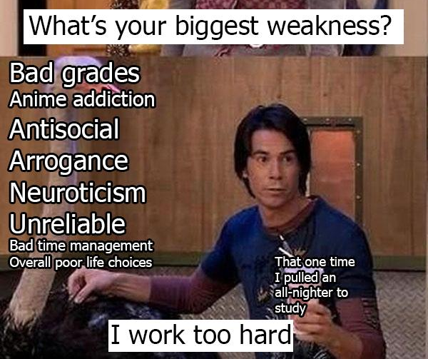
Interview Question:
What is your greatest strength?
What is a weakness or area of improvement?
Notes:
For Greatest Strength, begin by stating the strength then provide an example to “prove” or to “show” not just “tell” that you exhibit that strength
For the Weakness/area of improvement:
Don't restate the question. No need to name it "weakness" yourself as this gives more weight to it as a possible issue.
Start by explaining action you are taking or have taken to grow in the specific area and then mention why you are implementing the new strategies. Reversing the order will place the focus on your action instead of the issue itself.
There are weaknesses that will likely be significant red flags, so you should avoid naming these explicitly: procrastination, time management, organization. These topics will likely be a red flag that sticks in recruiter’s thoughts, and they won't hear your explanation after that.
You can use a common weakness, public speaking for example, or one that is natural for your stage in career, such as further developing technical skills

Slide 4
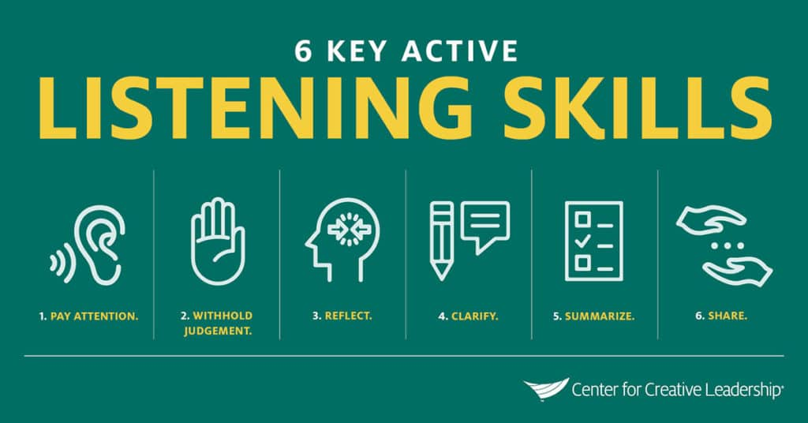
Workplace Tip:
Practice Active Listening
Notes:
Center for Creative Leadership: https://www.ccl.org/articles/leading-effectively-articles/coaching-others-use-active-listening-skills/
Pay Attention: allow wait time before responding; don’t interrupt or start formulating your answer before they finish, make eye contact
Withhold judgement: Be open to new ideas and perspectives, new possibilities
Reflect: Paraphrase key points to ensure you understand what they are saying.
Clarify: Don’t hesitate to ask questions about anything that is unclear or ambiguous
Share: Once you have a clear understanding of the person’s perspective, you can begin to share your own ideas, feelings and suggestions.

Slide 5
Find Alumni & Other Contacts
Outreach & Follow-up
Identify Target Employers & Opportunities
The Self-Directed Job Search Process
Two Types:
Highly Structured
Track, Track, Track
Quantity is important
Follow-up is critical
Less-Structured
Casting a wide net
General Networking
2.
Name of Employer | Job Title | Date Applied | Contact 1 | Email | Outreach Date | Follow-up | Contact 2 | Email | Outreach Date | Follow-up Date | Contact 3 | Email | Outreach Date | Follow-up Date
ABC Co. | Important Co-op | 1-Dec | John Smith | JS@abcco.com | 1-Dec | 12-Dec | Jill Smith | JSS@abcco.com | 1-Dec | 12-Dec | Bob Jones | BJ@absco.com | 3-Dec | 15-Dec
Notes:
There are two main approaches to the employer job search:
Unstructured: Networking, talking to people you have connections to in order to ensure everyone you knows, knows you are searching for a position
Structured: Identify a list of target employers and/or target positions, find contacts at the target companies, connect and follow-up. You will need to track your activities because your typically need to work at a higher volume than in the Drexel system to ensure success. If it takes 35 interview requests to get 2 interview sin the system, it might take 70-80 to get the same results via networking/independent job search strategies

Slide 6



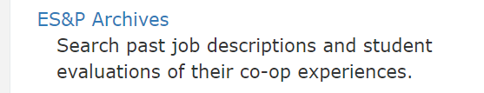

Identifying Target Employers
Notes:
The first step in a structured independent job search is to create your list of target companies. You can use a variety of platforms to identify employers who are hiring.
You don’t have to limit yourself to companies that have co-ops or internships listed for this step as any company that shows a hiring need is a warm lead to follow-up with about potential opportunities. You are thinking pretty broadly about employers who might have some work you could help with!

Slide 7
Following-Up/Finding Internal Advocates/Networking
LinkedIn Alumni Tool
Handshake
Dragon Network
Career Fairs/Employer Events
Family/Friends
Faculty
Notes:
Once you identify a list of employers you want to target, your next steps is to find contacts at those employers to reach out to. Many students find that starting with alumni is a great. You want to set a goal of identifying at least three people at each target company to outreach to.
LinkedIn alumni tool: Visit Drexel’s linkedIn page and click on the alumni tab to find a search tool that will enable you to filter on the alumni working at any target company
Handshake Students who Have worked Here tool: Go to the companies tab in handshake, search for a company and then scroll down to find the filter that shows you students who have worked at the organization, filter on Drexel to message students who have done co-ops or taken full time jobs at the organization

Slide 8
LinkedIn University
Alumni Tool
People Tab
Company Pages
Posts/Comments/Ongoing dialogue
Threshold to connect is low
Personalize Your Connection Request
LinkedIn
Profile headshot – 80% want to see
Strong Headline
Follow companies/people
Participate in conversations
Resume development/editing
Links to projects
Customize your URL – add to contact info on resume

Slide 9
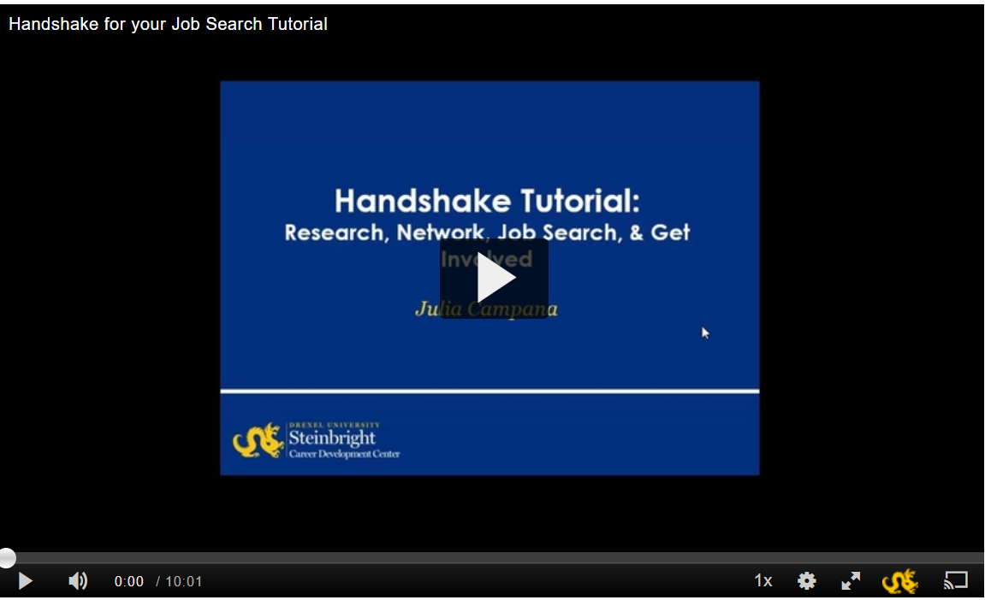
Follow Employers
Employer Contact in Handshake
Network with Students & Alumni
Events
Job Postings
https://1513041.mediaspace.kaltura.com/media/Handshake+for+your+Job+Search+Tutorial/1_0vw0zi33
Notes:
The link to this recorded webinar offers guidance on the features Handshake offers and how to set-up your account as a student.

Slide 10

Student User 101 - Get the Most Out of Your Dragon Network Experience
https://www.youtube.com/watch?v=HD0NJ6C91bg
Notes:
Drexel thinks it’s so important that you network with alumni that they have created their own platform, including a mobile app, to do so through the alumni association. Check out this 8 minute video highlighting the features of the Dragon Network, a platform to communicate with an network with alumni who volunteer to participate in the platform.

Slide 11
What do I say When I Outreach/Follow-up????
Connection Request
Personalize “I am a current Drexel Student hoping to connect with Alumni in the X Industry”
Informational Interview
https://www.themuse.com/advice/how-to-ask-for-an-informational-interview-and-get-a-yes
Gathering information/advice-Not a time to ask for a job or to necessarily offer you resume
Direct Follow-up
“I applied to X position, and I am hoping to follow-up about the application process”

Slide 12
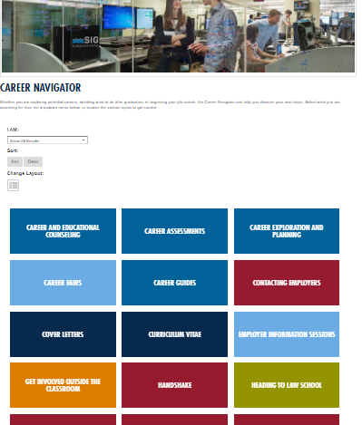
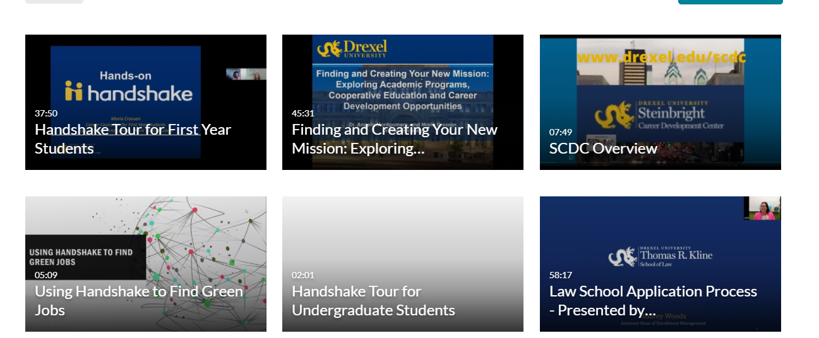
Steinbright Resources:
Career Navigator
https://drexel.edu/scdc/career-navigator/navigator/
Job Search Professional Pointers
https://drexel.edu/scdc/professional-pointers/job-search/
Streams Channel
Steinbright Channel - Drexel Streams (kaltura.com)

Slide 13
Networking Approach
Casting a Wide-Net: The goal of having conversations with multiple people, so everyone you know knows you are searching for a position
Employer Events: https://drexel.edu/scdc/calendars-events/events/
Career Fairs
Plan to attend Fall Career Fair in October!
Faculty
Notes:
Individuals in your everyday life including friends, family, classmates, professors, supervisors, co-workers, and members of professional associations within your industry can be helpful resources during your search.
Some suggested ways to network are:
Attend career fairs.
Schedule an informational interview.
Go to an employer information session.
Create a LinkedIn profile – LinkedIn is a great way to search for and connect with employers in your field of interest.
Join a club or student organization and network with peers – Upperclassmen may be able to share information about their own co-op experiences and connect you with recent graduates working in a career field you are interested in.
The more people you can connect with, the better. The connection can be through email, phone, or social media, but talking to someone face-to-face has the potential to make a lasting impression. Start with what is comfortable for you and then expand your methods of outreach. People will not know your skills or interests, your career goals, your co-op job search process, or your questions unless you make the effort to tell them. Networking takes time, but most often it will yield the best results in your job search. You will need to be your biggest fan and advocate in your job search – be ready to showcase your skills and promote your experiences when the situation calls for it.

Slide 14
Independent Job Search Registration
Send the following to your Co-op Advisor for Approval
Student Co-op Registration Agreement [DOC] – The Student Co-op Registration Agreement form is used to register placements obtained either through a self-directed job search or during the C Round.
Job Description
Offer letter or email from the employer to myself confirming your employment dates, pay rate, number of hours per week
Employer Agreement Form [PDF]
Notes:
This is the list of documents your Co-op Advisor will ask you to submit to register an independent job search position that was not posted in A,B,C Round of Drexel Developed job opportunities. If you are interviewing for a position, and it looks like it might be a possibility, contact your Co-op Advisor to update them on the type of position and to inquire about possibility of registering it as your co-op.

Slide 15
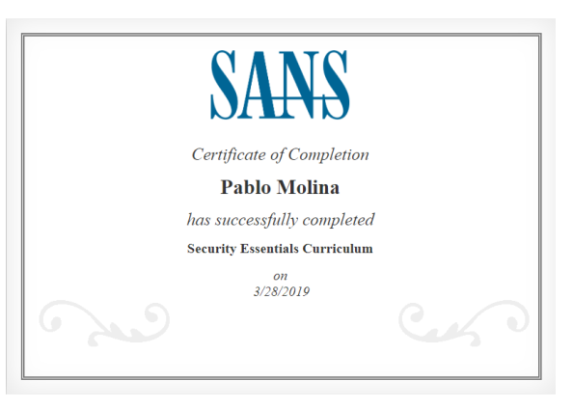
Information Security
NEVER PAY Money FOR A CO-OP – Avoid scams. If they are asking you for money, it is a SCAM!
DUST, Drexel University Security Training.
One-hour self-guided online course that you can take at your own pace. Sign up by sending an email to informationsecurity@drexel.edu.
Receive a certificate to build your resume and to demonstrate that you know and care about information security.

Slide 16
Due By Class Start Time Week 7: LinkedIn Assignment: 10% of Your grade!
TO SUBMIT: Use Submission Link in Week 6 Course Content Folder on Blackboard
FOR FULL CREDIT: All sections of your resume should be included in your LinkedIn Profile!
Your LinkedIn profile should develop as your resume develops!
Find Your LinkedIn Public Profile URL:
If your LinkedIn profile is set to public, it’ll have a link (URL) you can use to share your profile with others.
To find your public profile's URL you can use a search engine and search for your First and Last Name and LinkedIn as search terms. You can also sign in to LinkedIn and do the following:
Click the Me icon at the top of your LinkedIn homepage.
Click View profile.
On your profile page, click Edit public profile & URL on the right rail.
Under the section Edit URL in the right rail, locate your public profile URL.
It'll be an address that starts with www.linkedin.com/in.

